Slide 1

LNG INSURANCE
Team No : 18
Presented By
Neha Zulfiqar Khundmiri
Jai Ganesh
Lisha Bohra

Slide 2

Table Of Contents
Page No | Pages
3-4 | Home Page
5 | About Us Page
6-7 | Insurance Page
8 | Home Insurance Page
9 | Auto Insurance Page
10 | Vacation / Travel Insurance Page
11 | Belongings Insurance Page
12 | Childcare Insurance Page
13 | Health Insurance Page
14 | News Page
15 | Contact Us Page

Slide 3
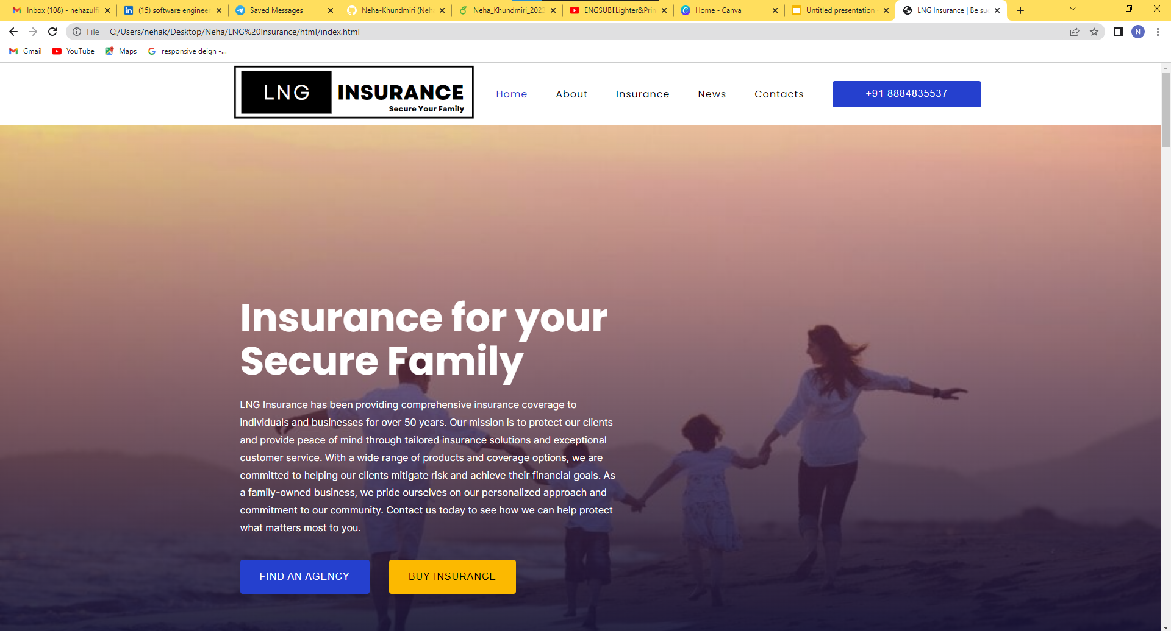
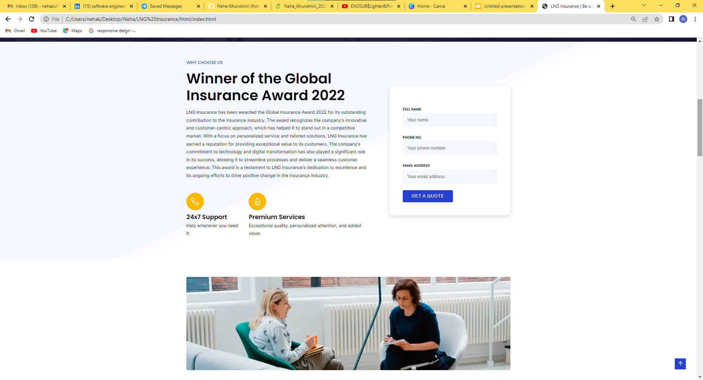

Slide 4

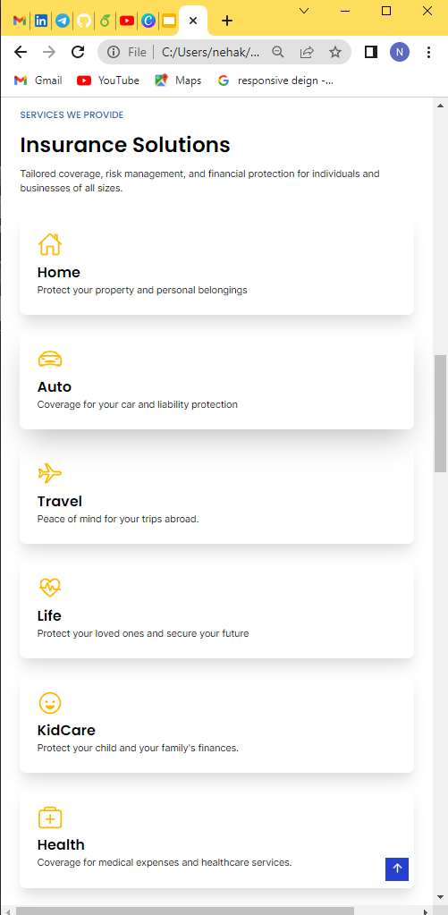
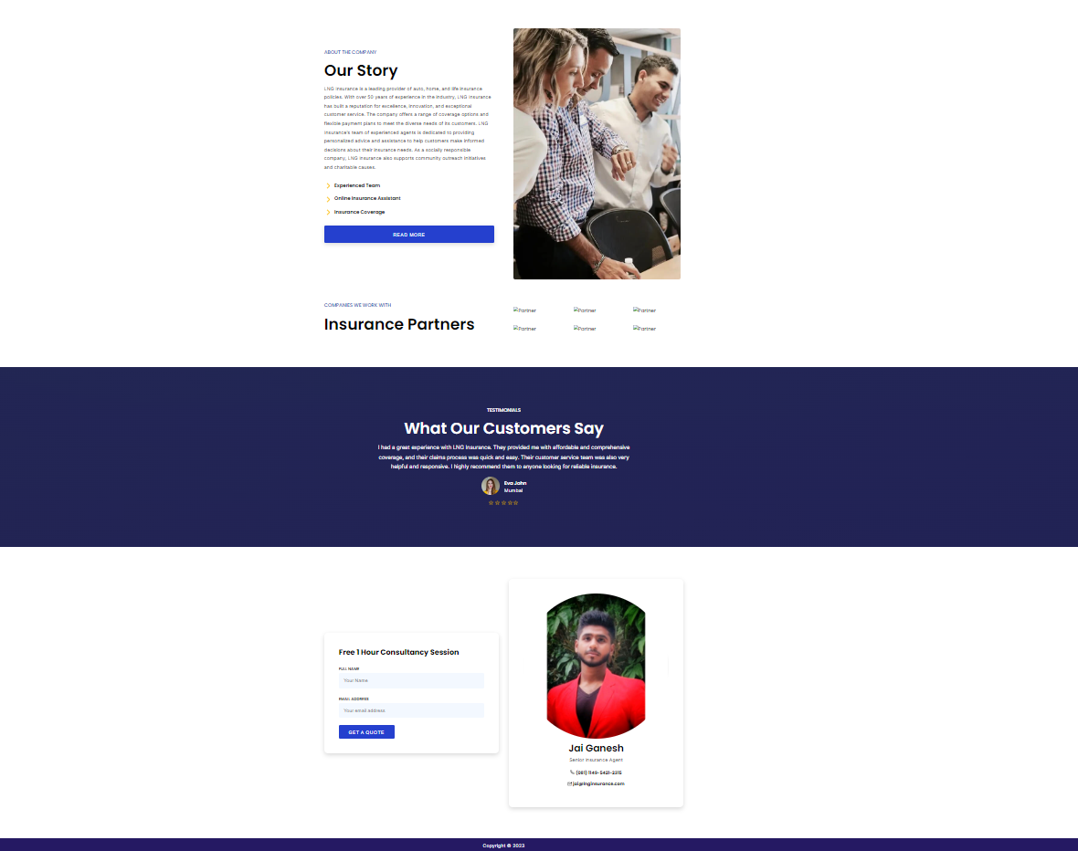

Slide 5

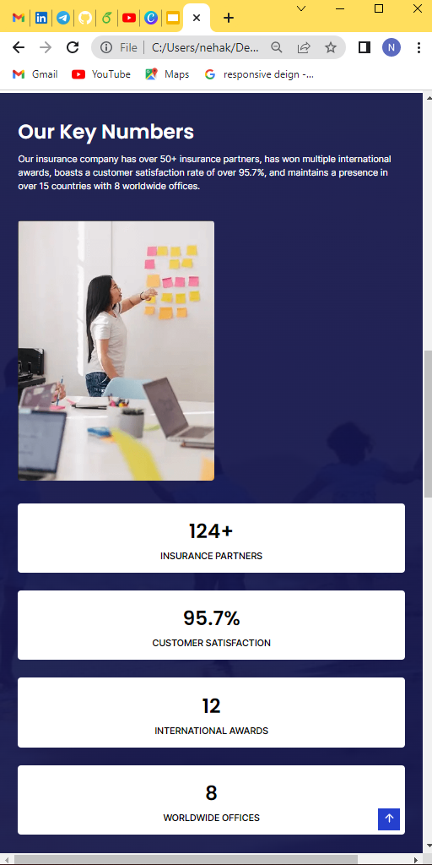
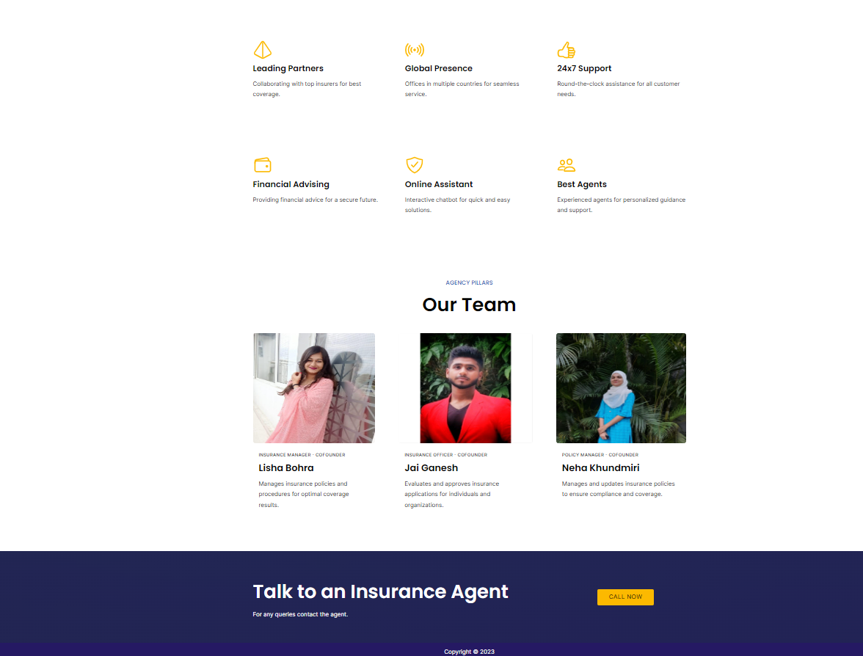

Slide 6

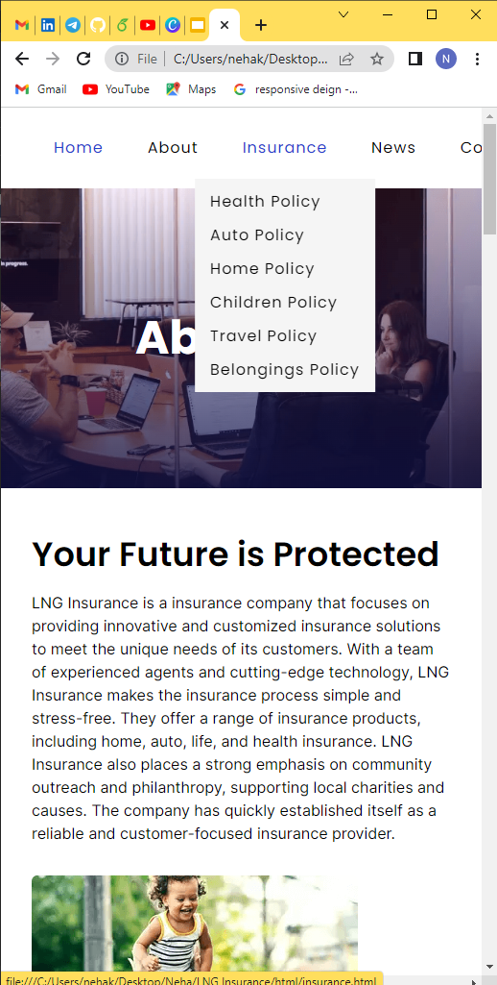

Slide 7
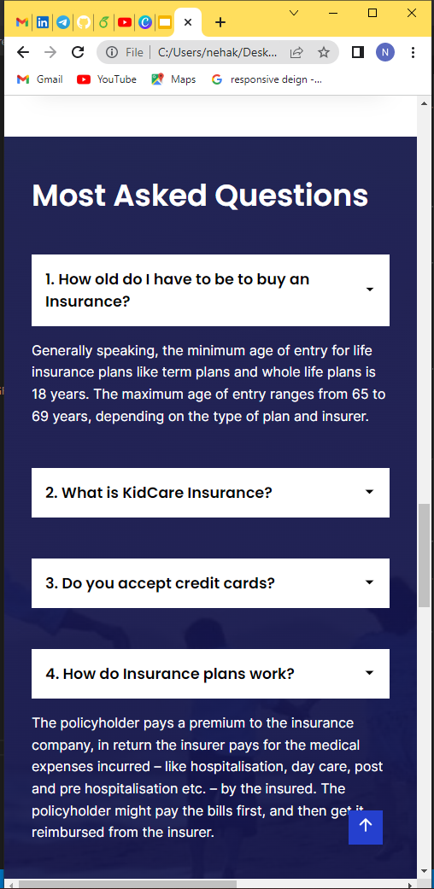
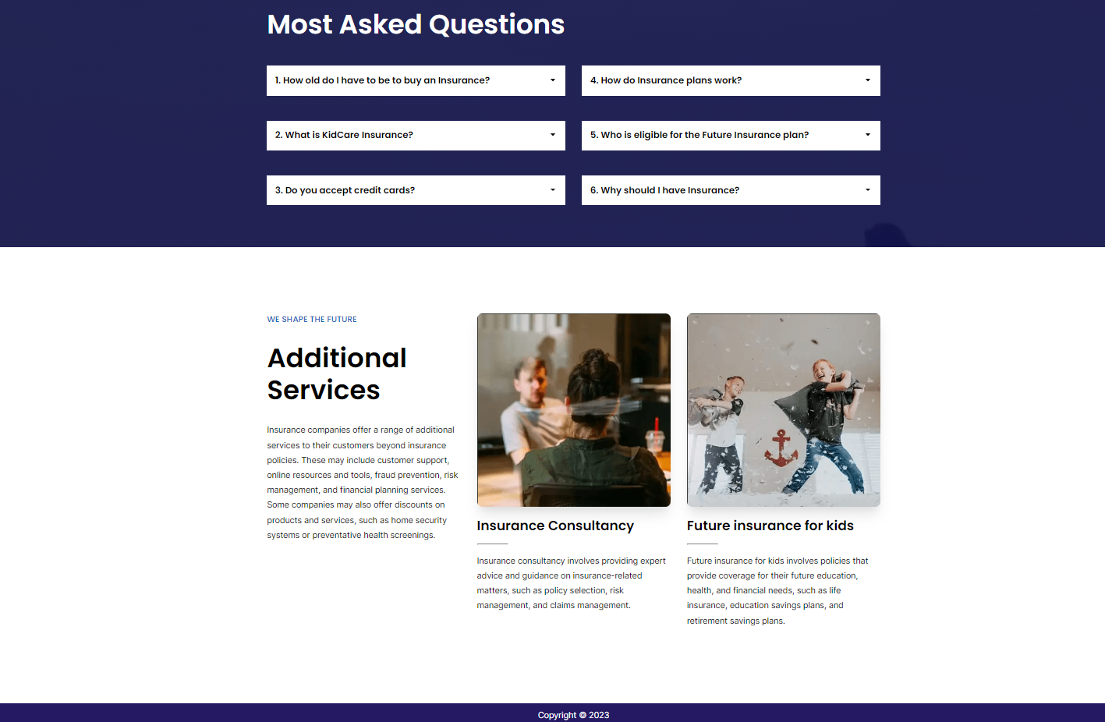

Slide 8


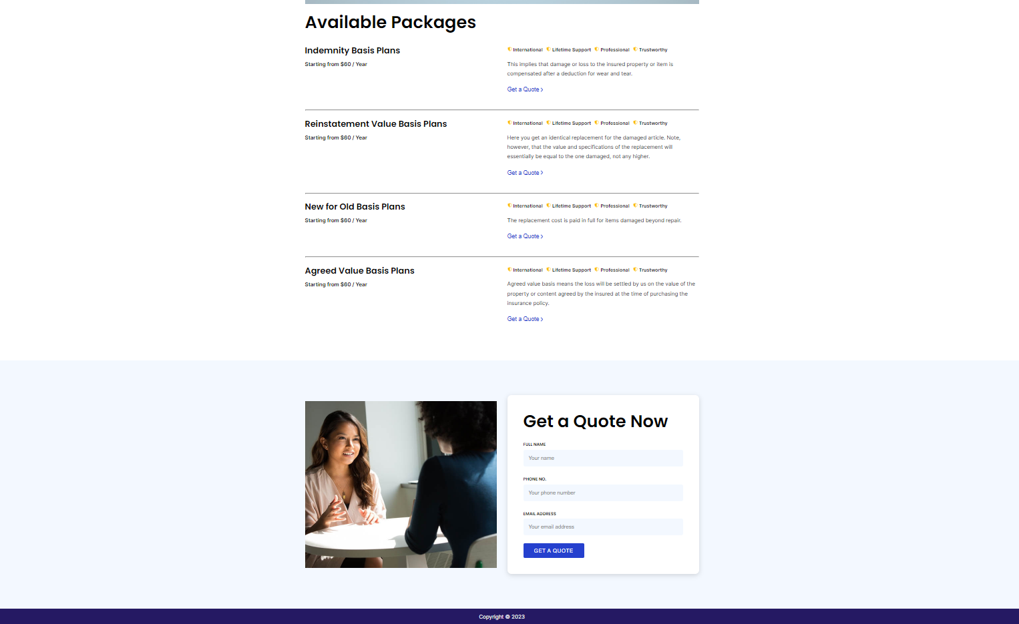

Slide 9



Slide 10
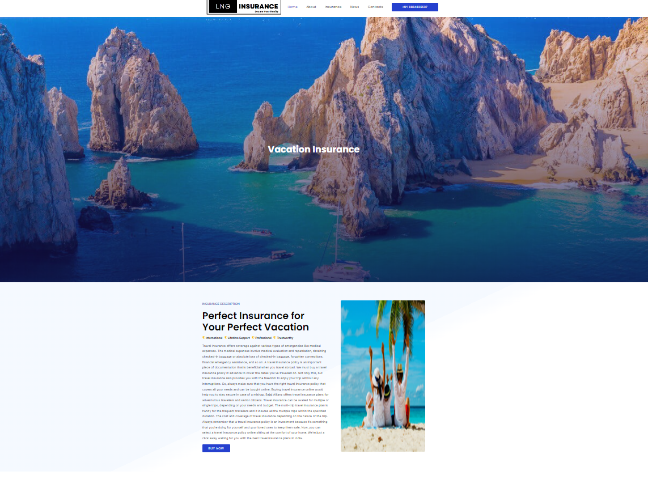
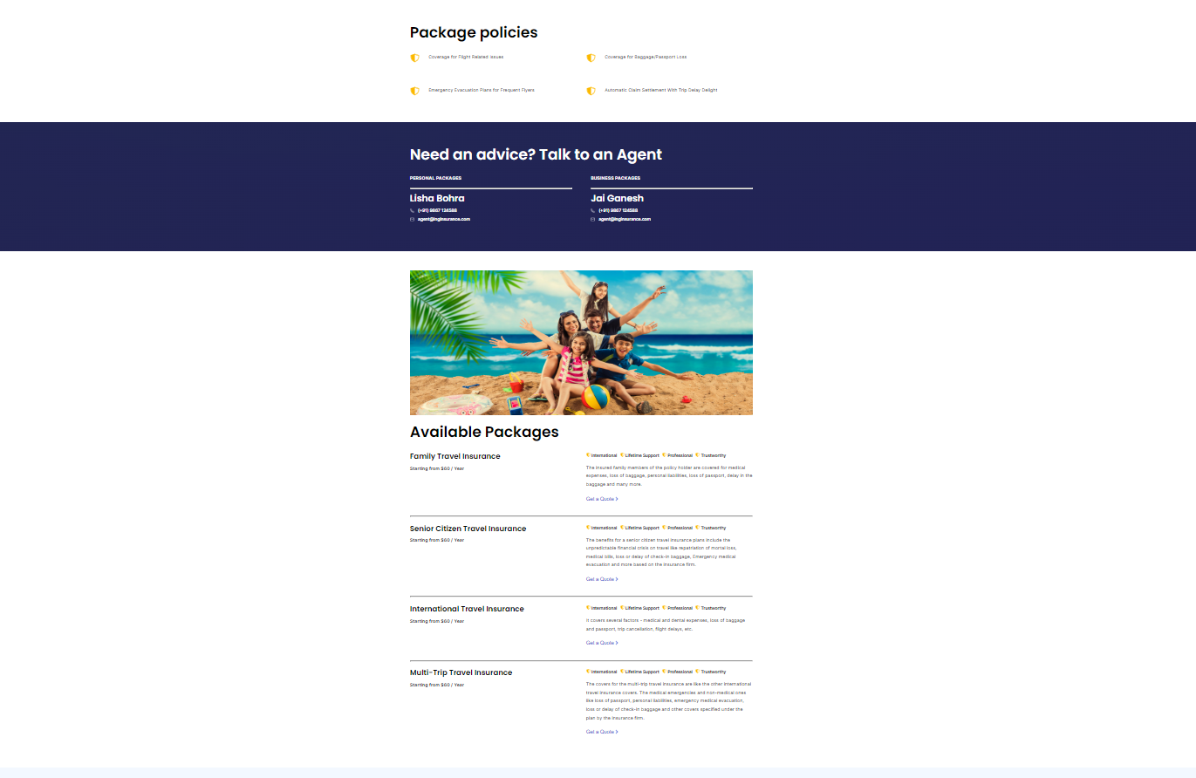

Slide 11

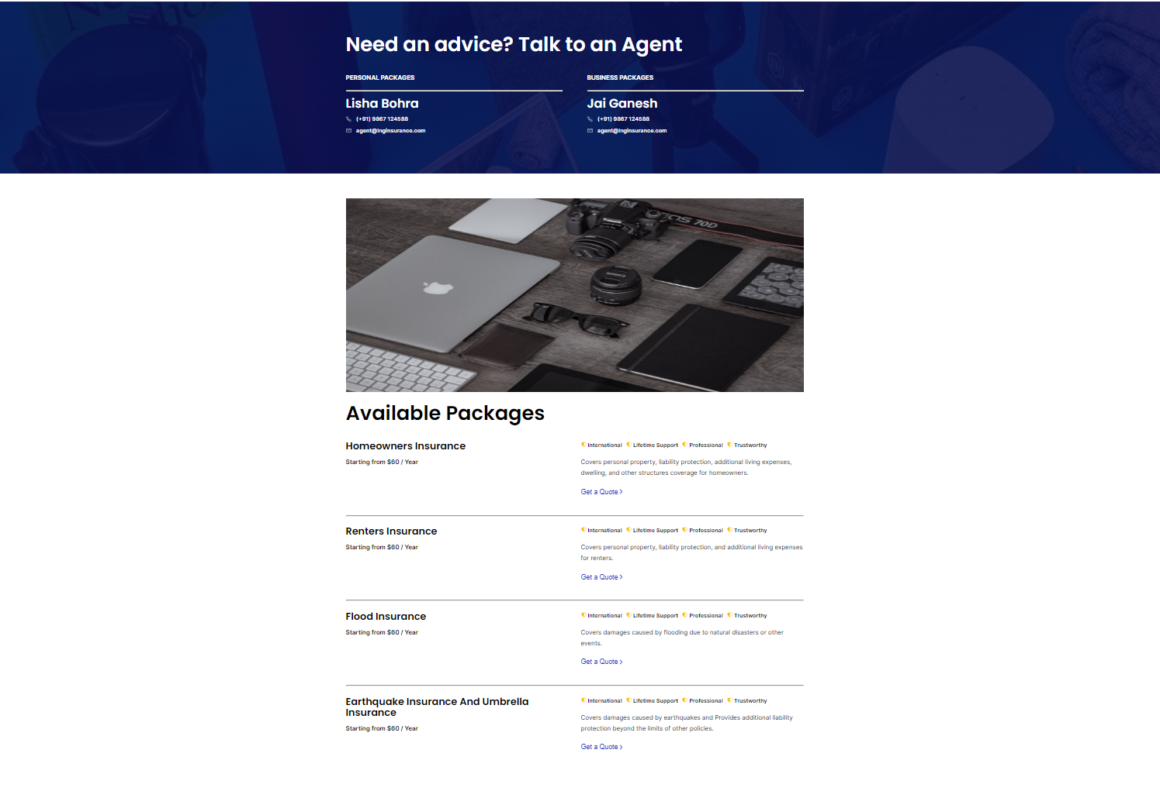

Slide 12



Slide 13
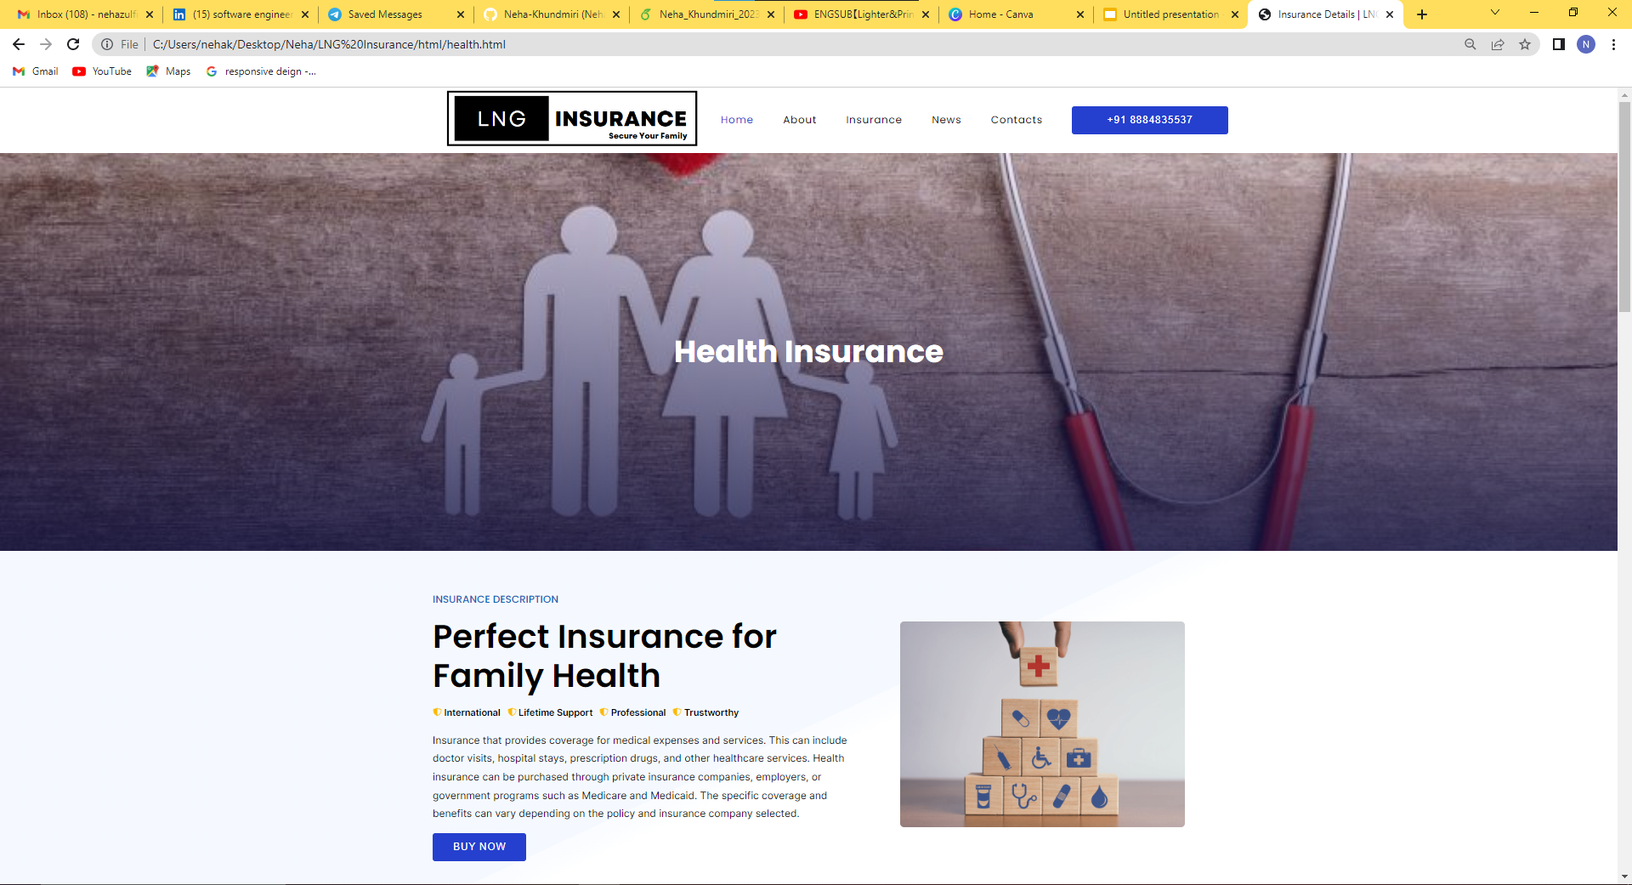


Slide 14

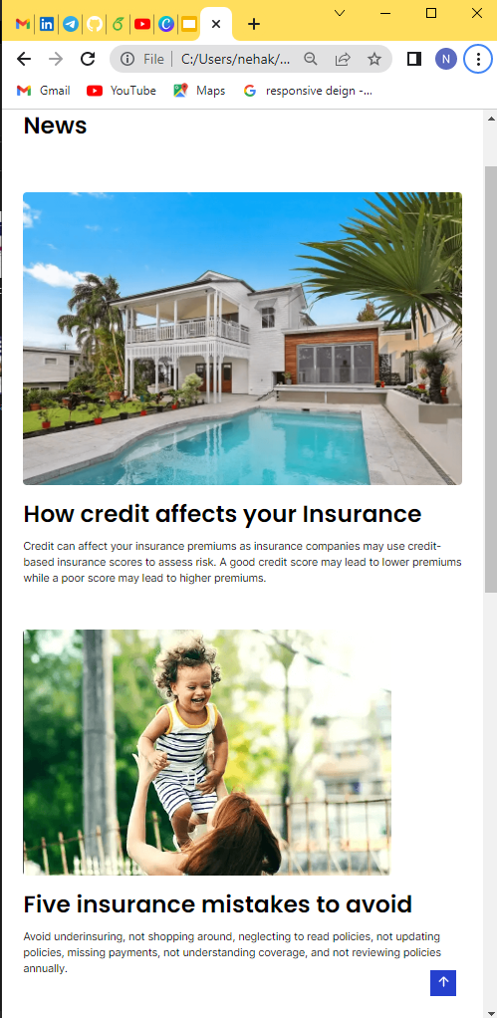

Slide 15
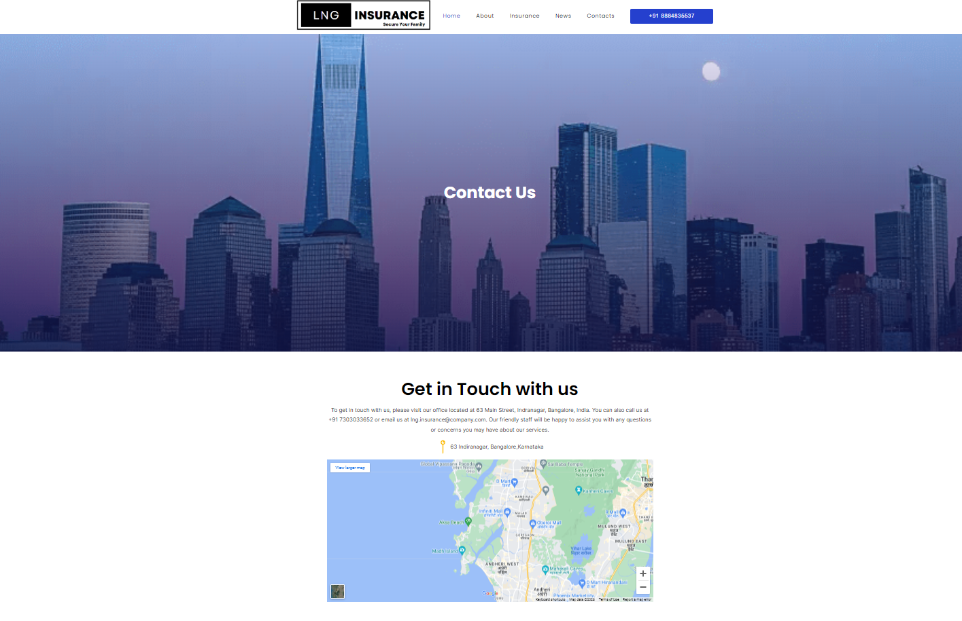
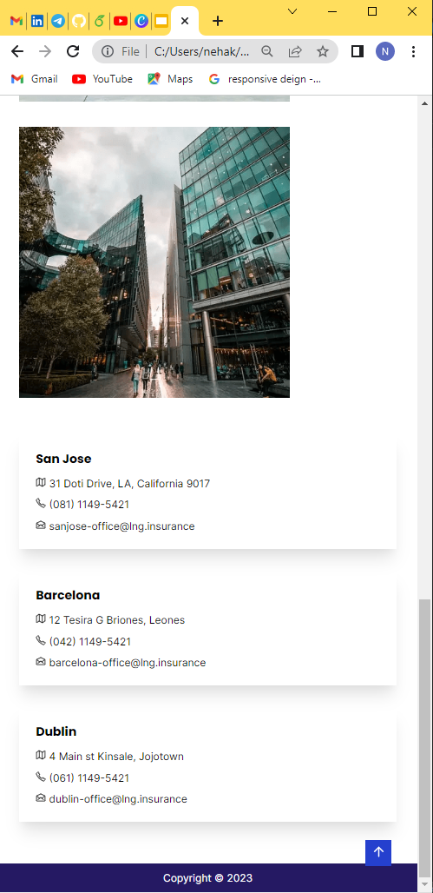

Slide 16
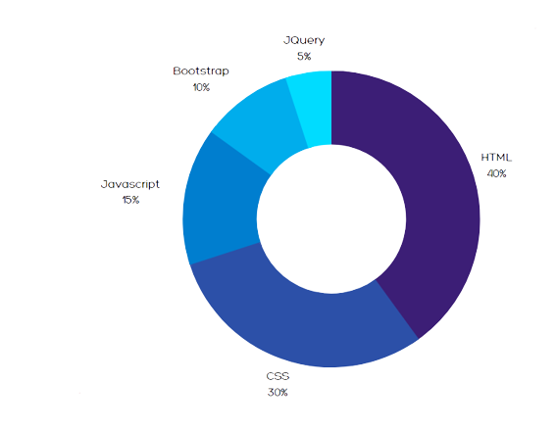
Technologies used
HTML
CSS
JAVASCRIPT
BOOTSTRAP
JQUERY

